Slide 2
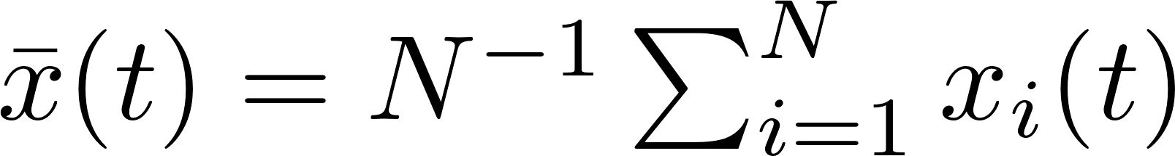
Summary Stat for FD
Mean
Variance

Slide 3
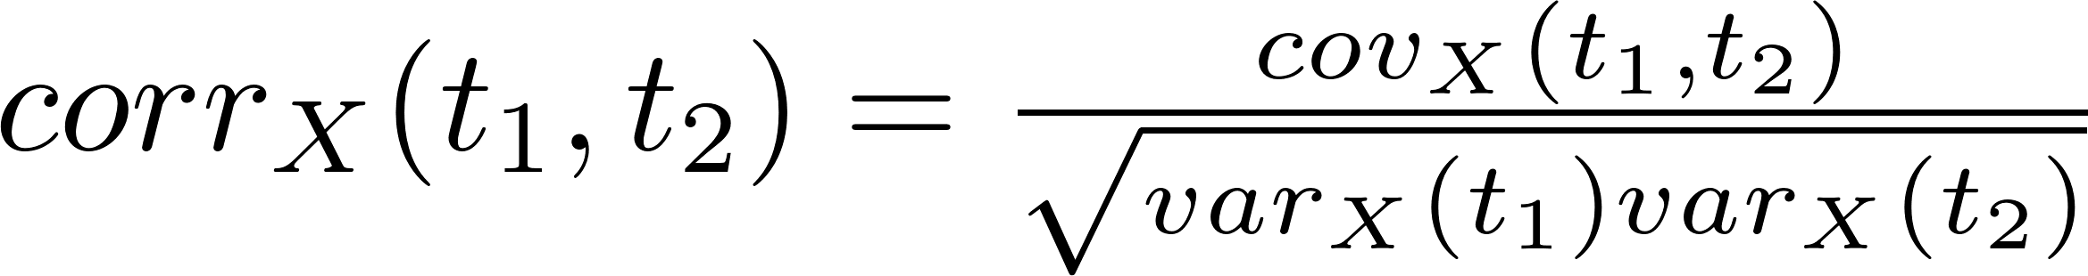
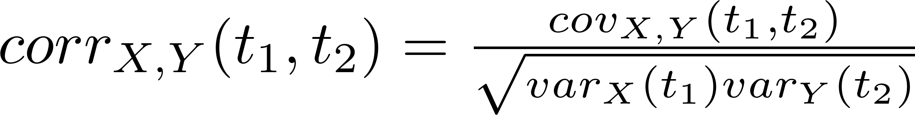
Covariance and Correlation functions
Covariance
Correlation
Cross-covariance
Cross-correlation

Slide 4
ANATOMY OF A FUNCTION
Feature
levels, crossing, peaks/valleys
Data Resolution and Functional dimensionality
Total amount of information required to define it as demanded
Size
Phase-Plane plots

Slide 5
From Data to Function
Basis functions combination
Powers (Polynomials)
Fourier (More suitable for periodic data)
B-spline
wavelet
Calculus of variations
Functional analysis

Slide 6
Why treating data as functional
Assumptions:
Underlying functions is continuous and smooth(Ds exist)
Normally we should have assumption that y(j) and y(j+1) are linked to some extent that they are unlikely to be too different. If not, just treat data as multivariate

Slide 7

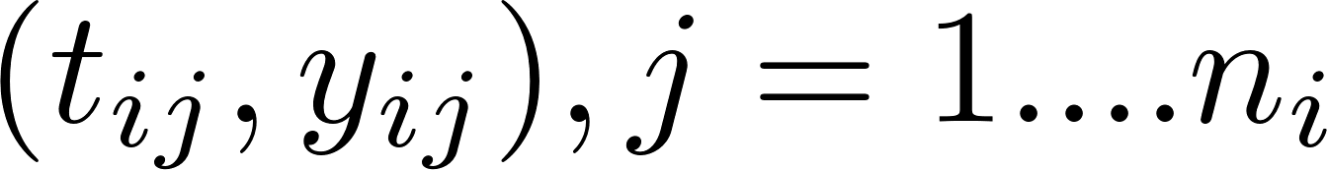
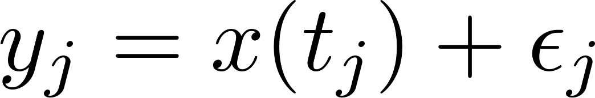
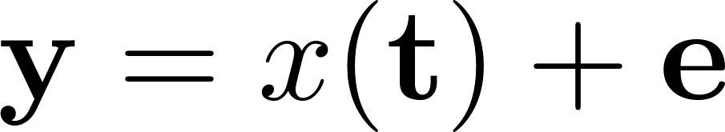

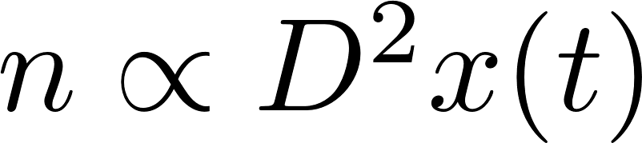
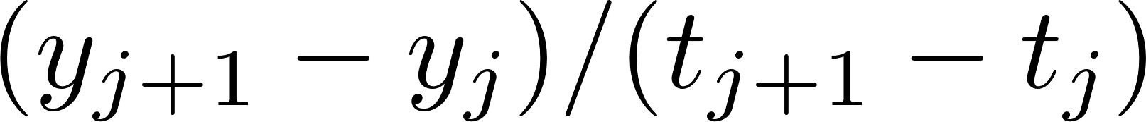
Model data
We normally have pairs of
Normally we smooth each record separately
About sample rate/resolution of data
Derivative est.
First forward difference
Central difference
Second central difference estimate

Slide 8
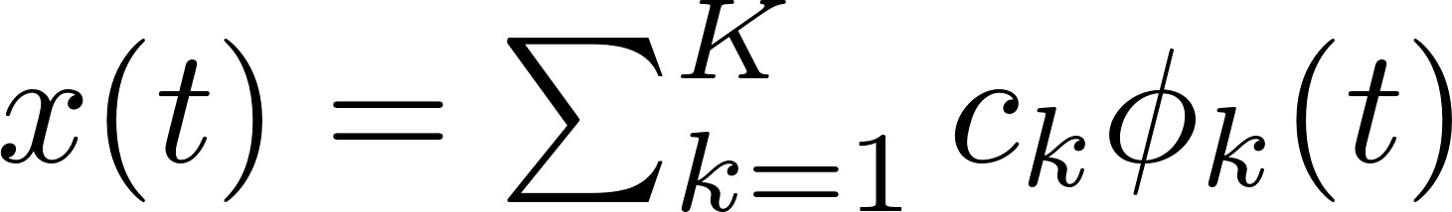
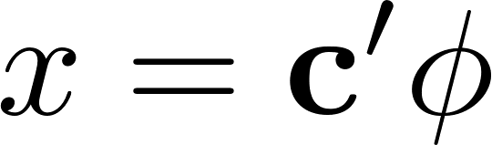
Representing functions by basis functions
Weighted sum of basis functions
Choosing basis
Small k
Derivative behave reasonably

Slide 9
Fourier Basis System

Slide 10
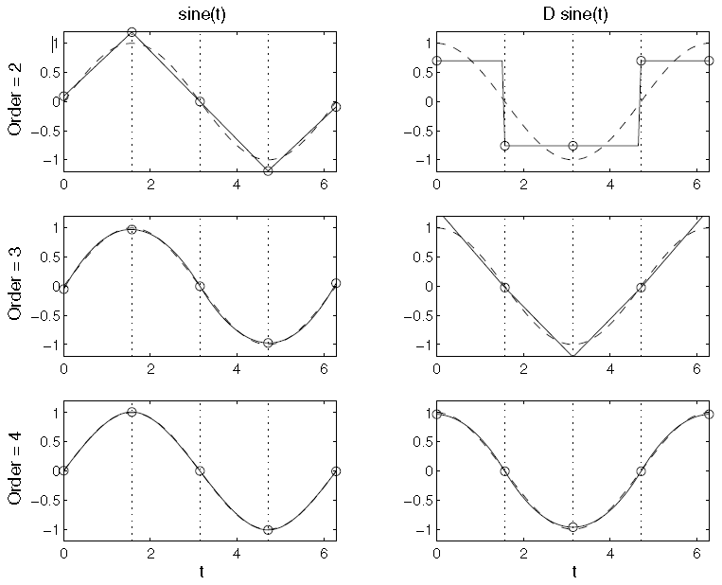
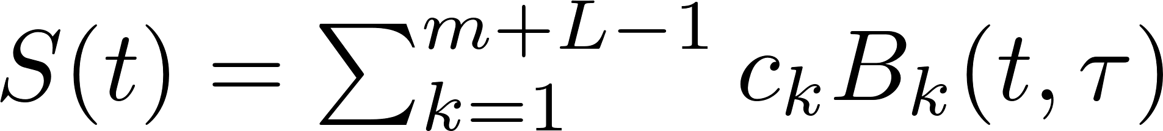
Spline basis
Divide interval into L subintervals
Df of fit=order(m) + L-1
Higher order brings better fit, normally order of 4 and 5 works for most functions
The more breakpoints bring higher flexibility
B-Splines
m: order
L: subintervals
Notes:
Order m = highest degree of polynomial + 1

Slide 11
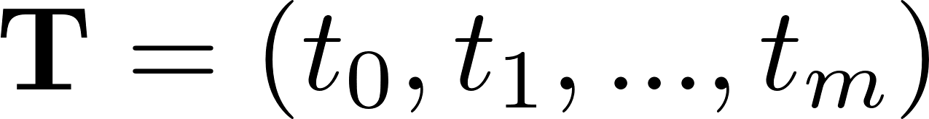
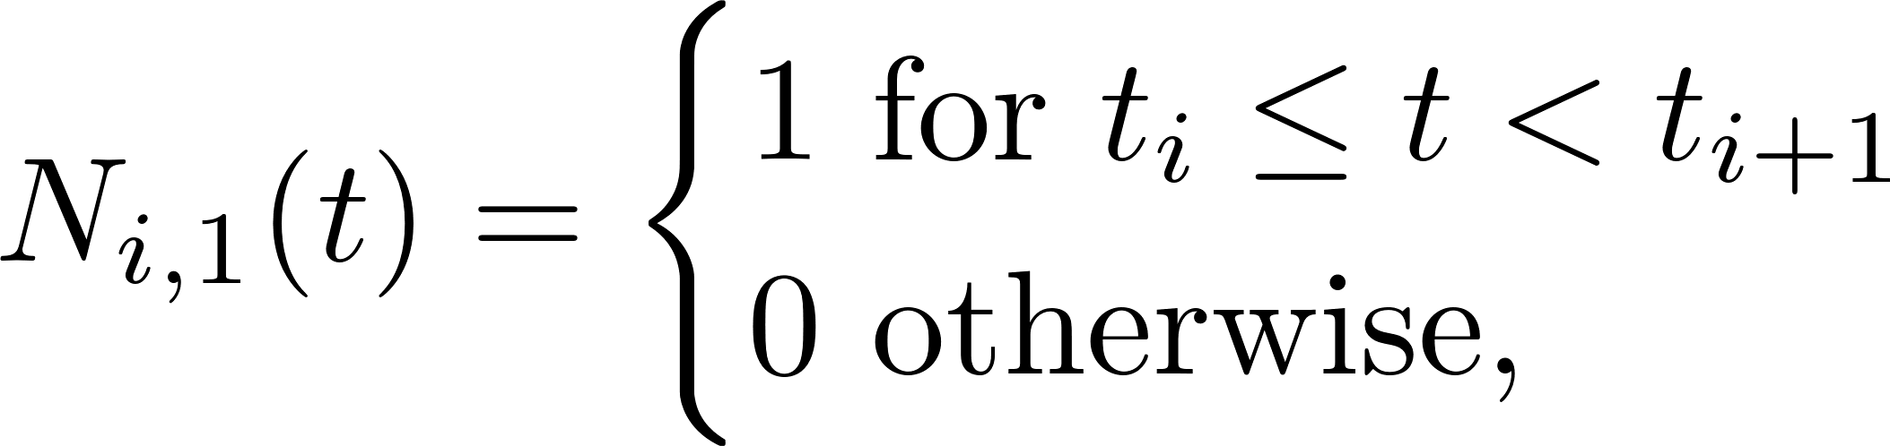
B-Spline
Order k B-spline: joining several pieces of polynomials of degree k-1 with at most D(k-2) continuity.
Define:
Knots:
B-spline basis function:
Then:
We will define function degree: m (quadratic,3. Cubic, 4. …)
We will define how many intervals (L) and where the knots are
Then we need to add m-1 knots to each boundary, and any number of knots in the middle. The number of intervals in L, knots(if all distinct in interval) is L-1.
Now we need m+L-1 basis functions. And we define the spline function as
So the problem left to modeler is
Where to put interior breakpoints
Equal spaced
At quantile of sampling points (or At sampling point, called ‘smoothing splines’)
There are some algorithms can help
Increase m will fit better but increase L might not (trade off between bias and var)

Slide 12
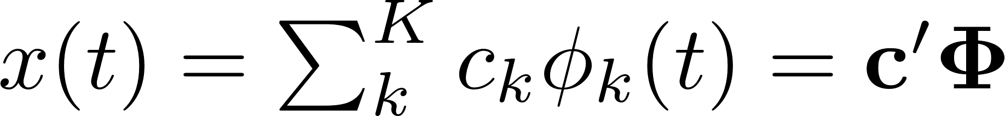
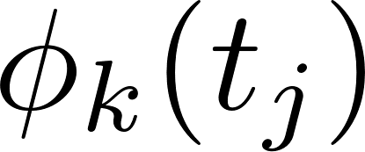
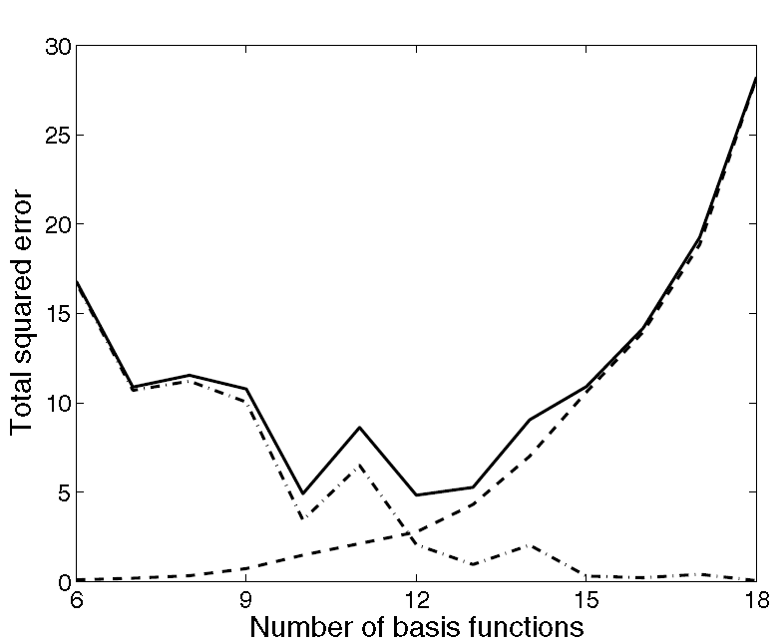
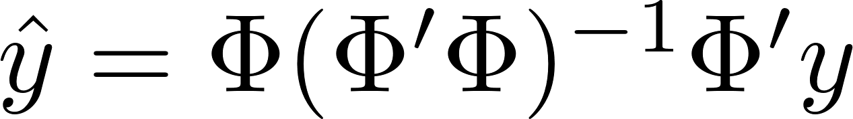
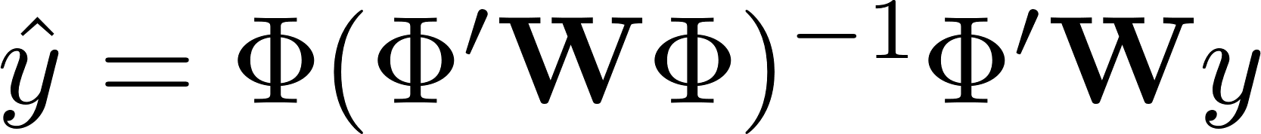
Smoothing functional data by least square
Fit
Choose K: number of basis equations
MSE=Bias2+Var
Forward/backward selection
Notes:
The boundary estimate pools much less information than do interior
estimates, and is especially sensitive to the boundary observations

Slide 13
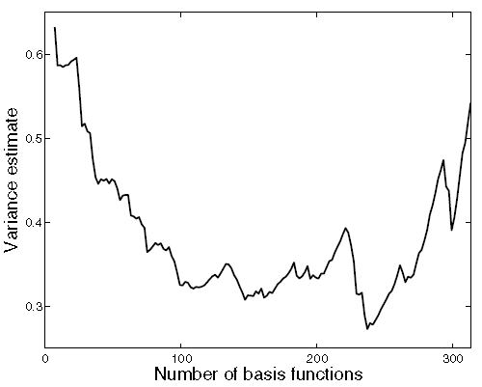


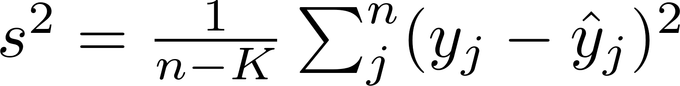
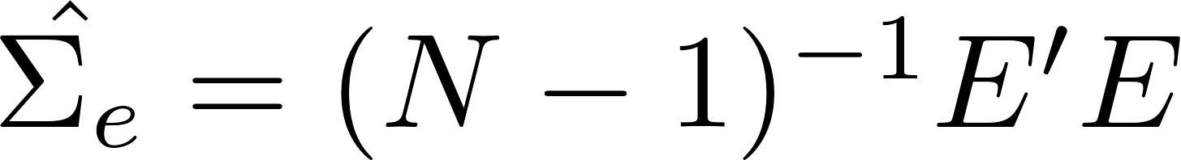
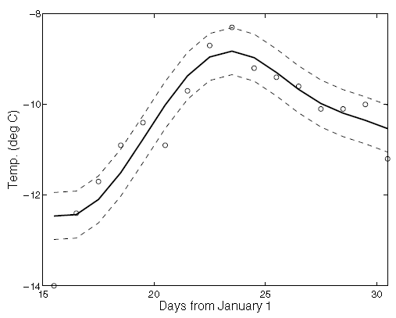
Confidence limit
Variances:
Estimating
When standard model for error is accepted
This is better than MLE
Generalized cross-validation
Assume autoregressive (AR) structure when N is small
When N is large, we have residual matrix E, but normally not possible
CL
Promblems
We assume K fixed
Pointwise CL itself is biased
Notes:
N is replications

Slide 14
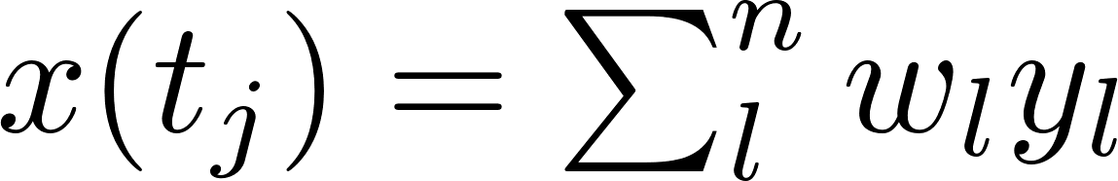
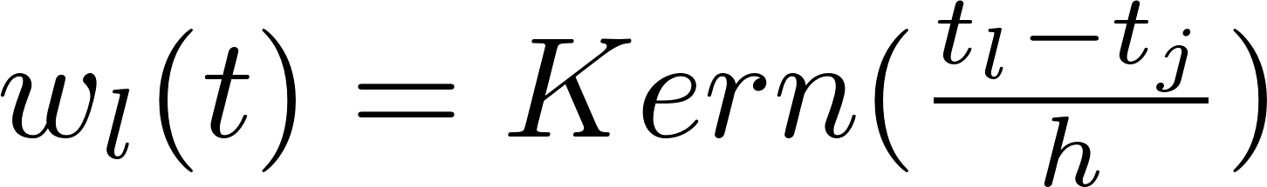
Localized least square
h: bandwidth parameter
Pro:
easy to understand
Excellent computational characteristics
H is well-explained
Cons:
Instable boundary performance

Slide 15
Localized basis smoother
Adapts well to unequally spaced arguments

Slide 16
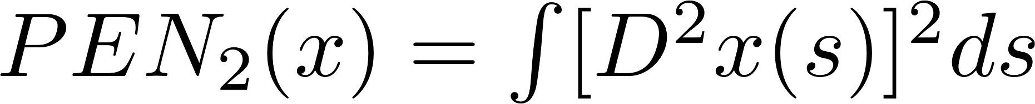
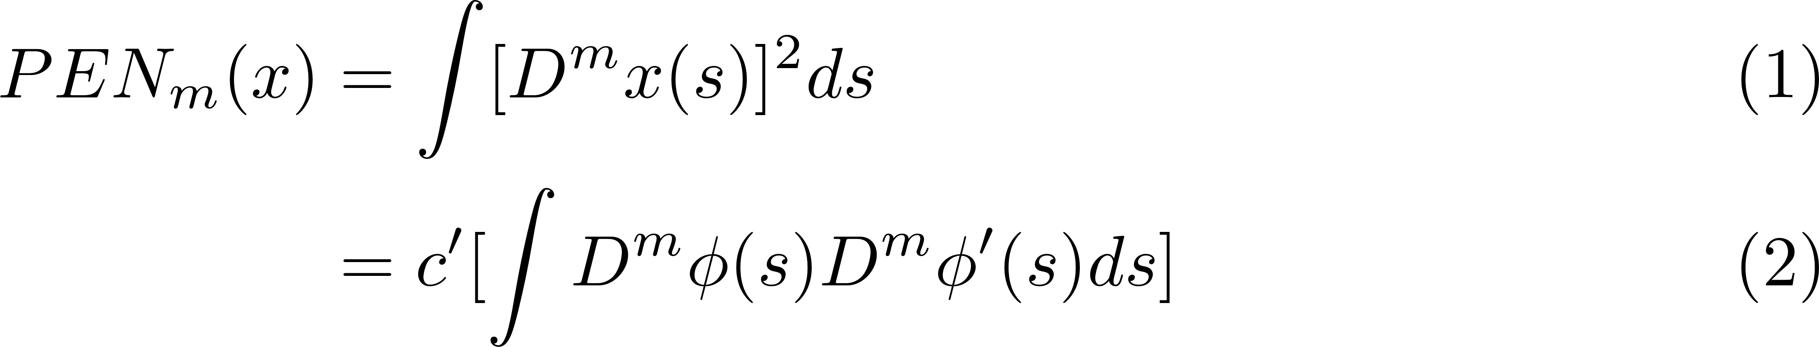
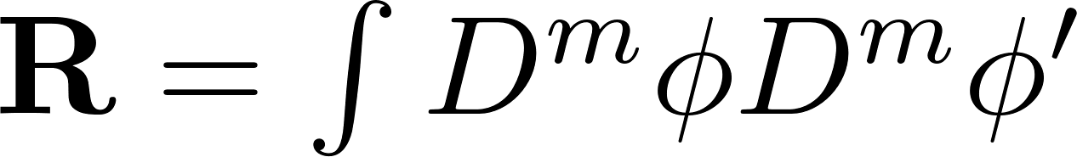
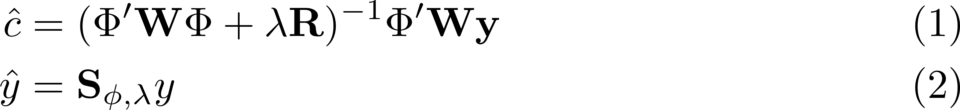
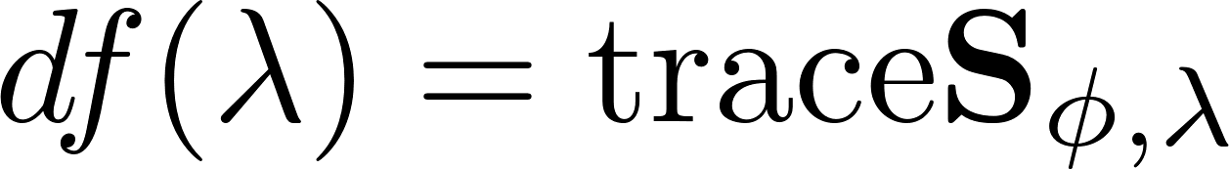
Smoothing with roughness penalty
Measure of roughness
Fitting criterion
Thm: the curve x that minimizes PENSSE is a cubic spline with knots at the data points tj.
Strategy (most common): Order 4 B-spline basis function expansion with knots on sampling points, minimizing above criterion

Slide 17
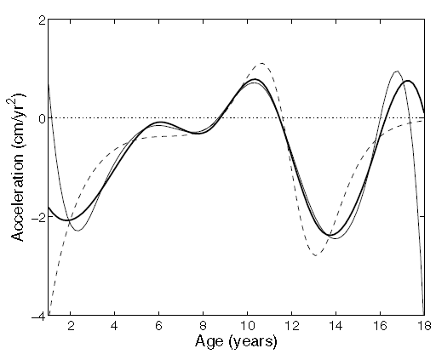
We want to control curvature of the highest order of derivative we are interested (choose m). If we are interested in acceleration, we control D4
Comparing to LS estimates

Slide 18
Extension of Spline smooth
Avoiding putting knot on each sampling point when too many (hand-writing)
Use likelihood instead residual sum of squares
Different PEN

Slide 19
Choosing smoothing parameter
Norm of R is increasing along the order and number of basis functions
Upper limit: A rough rule of thumb is that the size of λR should not be more than 10^10 times the size of ΦWΦ. Or inverse will be bad if possible.
Lower limit: Choose λ at least large enough to ensure that the size of λR is at least with ten orders of magnitude of the size of ΦWΦ.

Slide 20
Cross-validation
cross-validated error sum of squares (LOO)
Too intensive to compute
Tend to fit noise

Slide 21
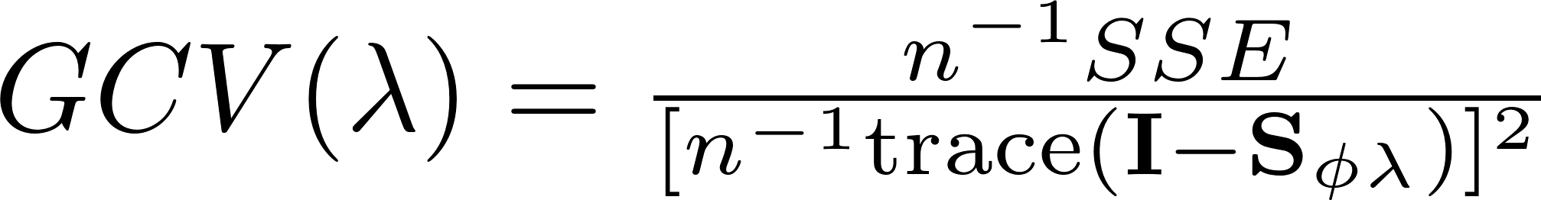
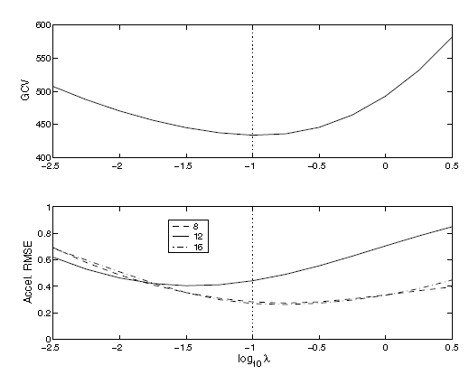
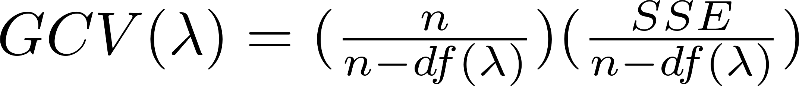
Generalized cross-validation

Slide 22
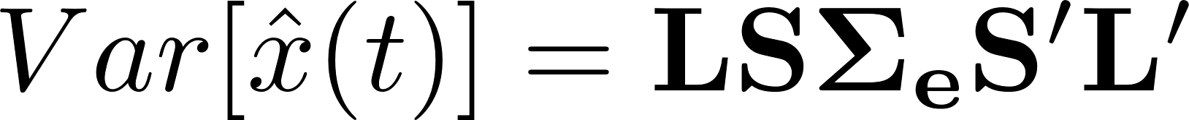
Confidence limits
y2cMap
c2rMap
y2rMap

